Slide 1
Mechanisms
Joren Janzing

Slide 2
Content
Recap
Proposed Mechanisms
Evidence for option 1.
Evidence for option 2.
Summary of Story So Far

Slide 3
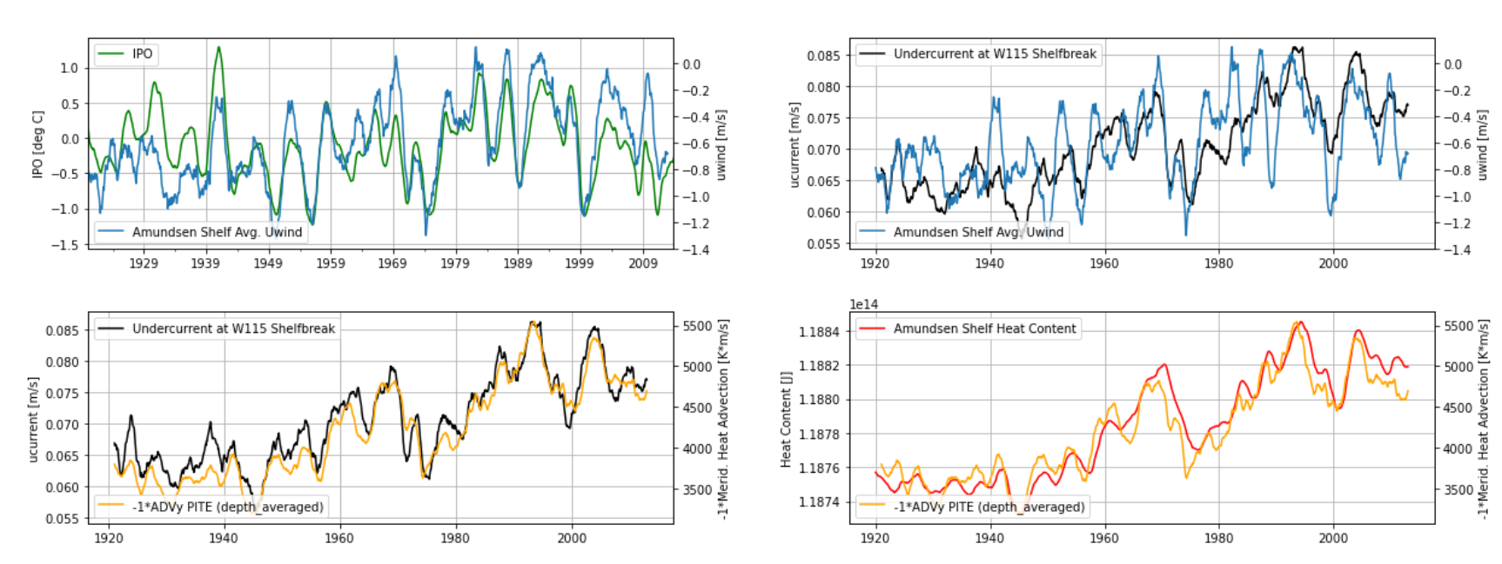
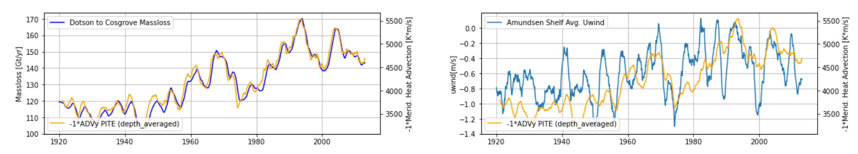
Recap: Ensemble Mean

Slide 4
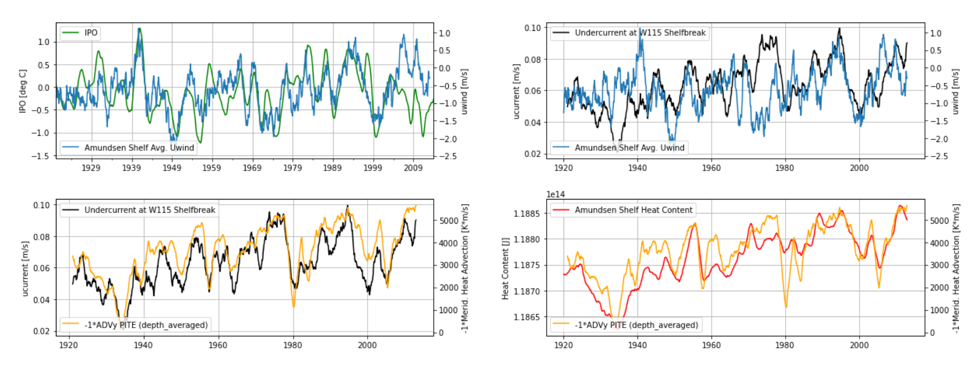
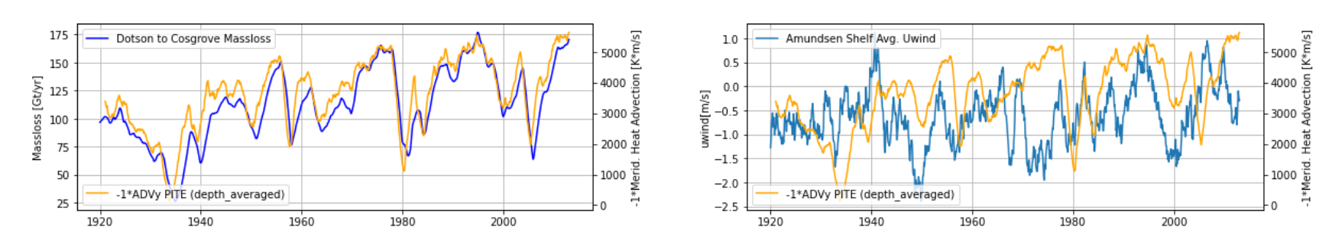

Slide 5
Proposed Mechanisms
Zonal Wind Stress (and curl)
Option 1:
‘As simple as that’
Undercurrent
Glacial Melt
Heat Advection on Shelf

Slide 6
Proposed Mechanisms
Air temperature, radiation
Zonal Wind Stress (and curl)
Option 2:
‘It’s complicated…’
Sea Ice
Small loop:
-pierre mathiot
Sea ice loop:
-david bett
Density (T, S)
Undercurrent
Glacial Melt
Heat Advection on Shelf
Switching between baroclinic and barotropic effect?

Slide 7
Evidence for Option 1

Slide 8
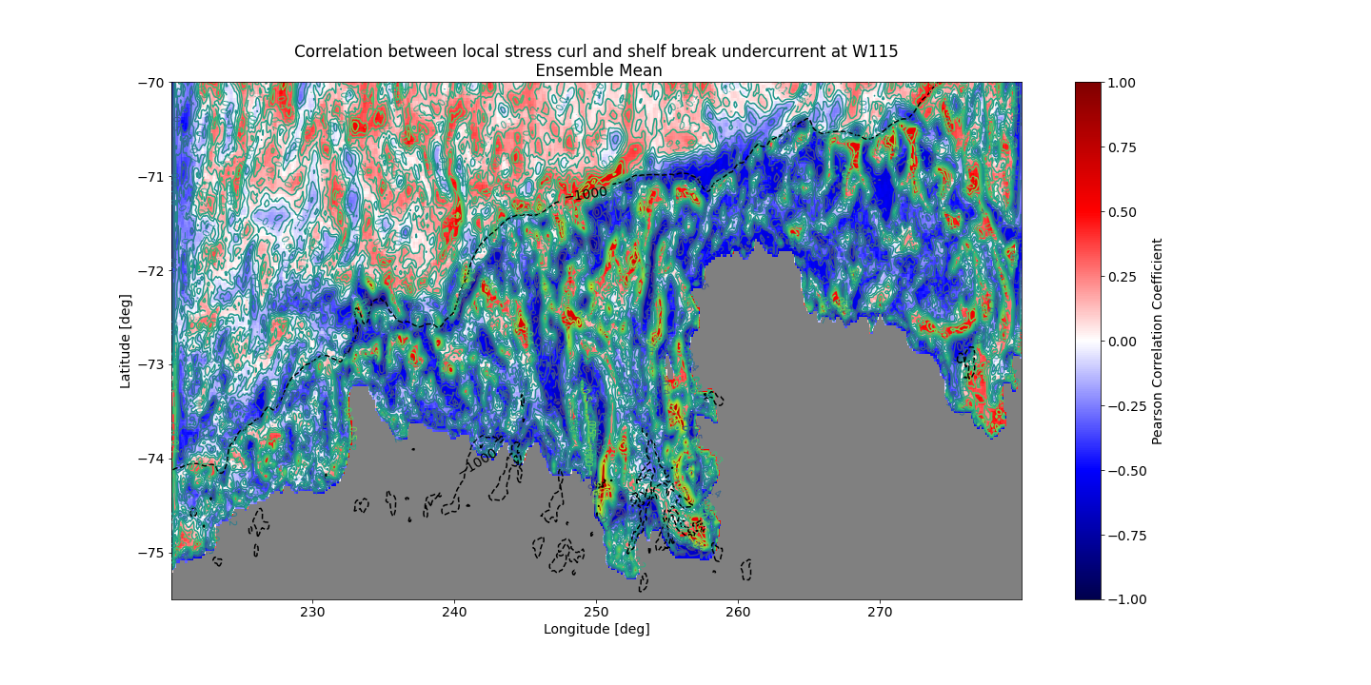

Slide 9
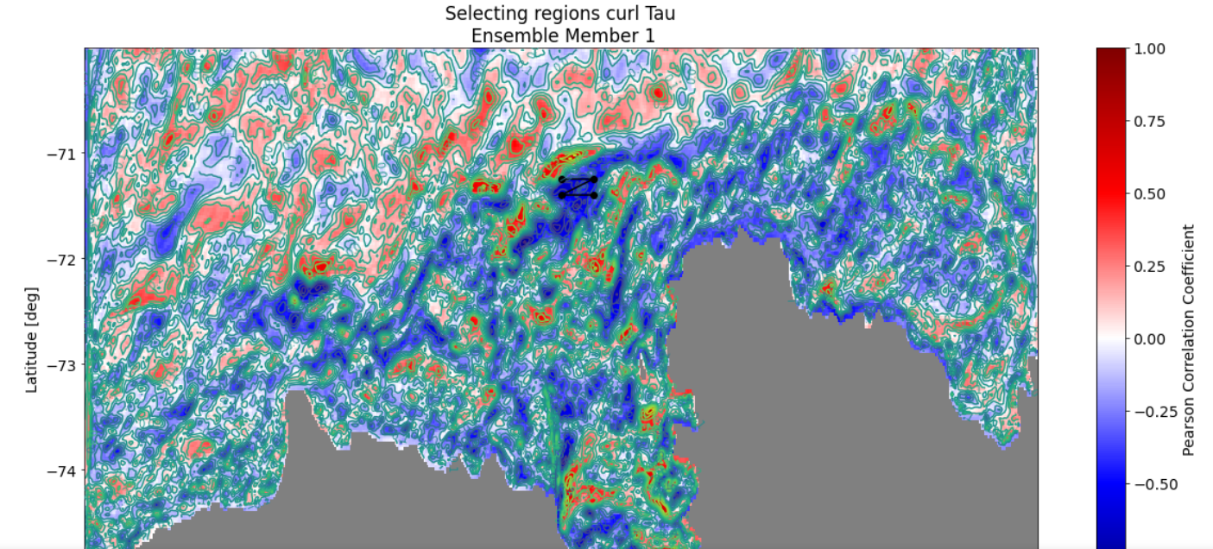

Slide 10
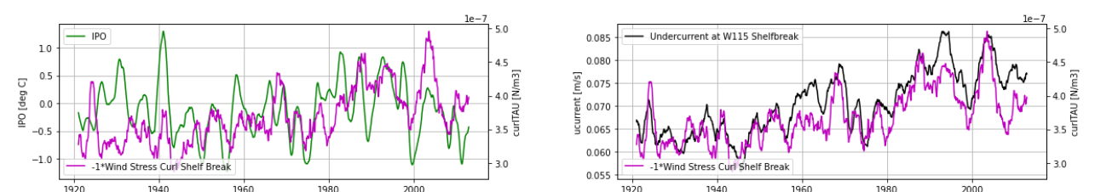
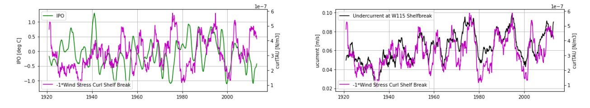
Stress Curl: Ensemble Mean
Stress Curl: Ensemble Member 1
Causality?

Slide 11
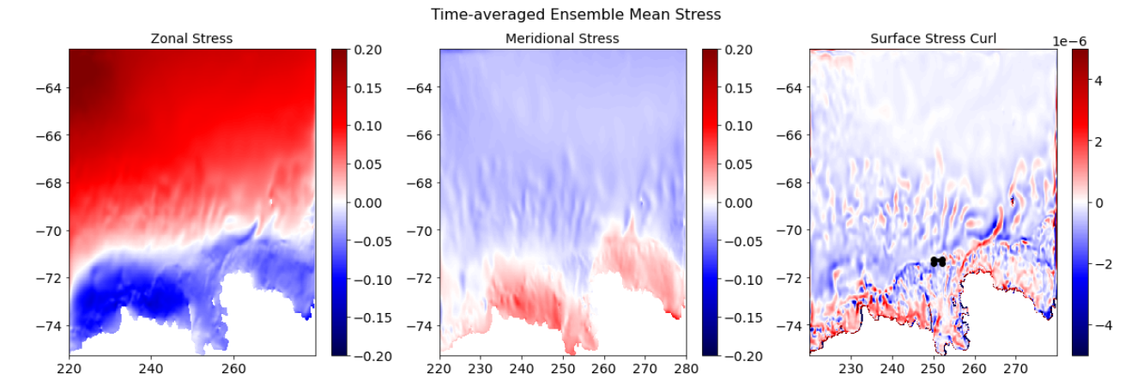

Slide 12
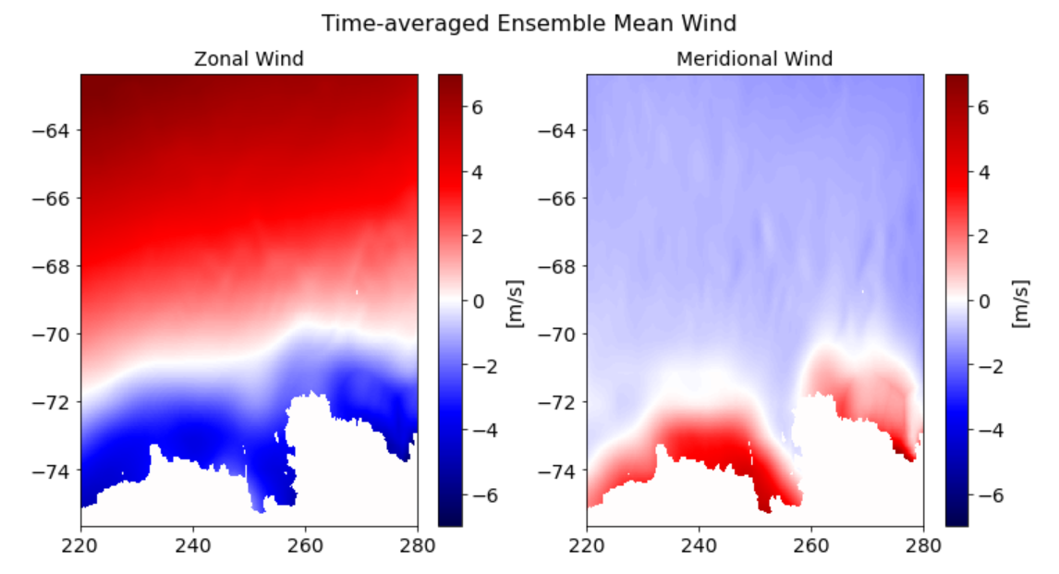

Slide 13
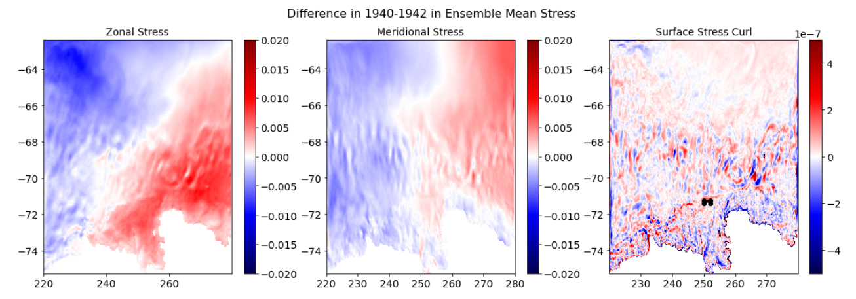

Slide 14
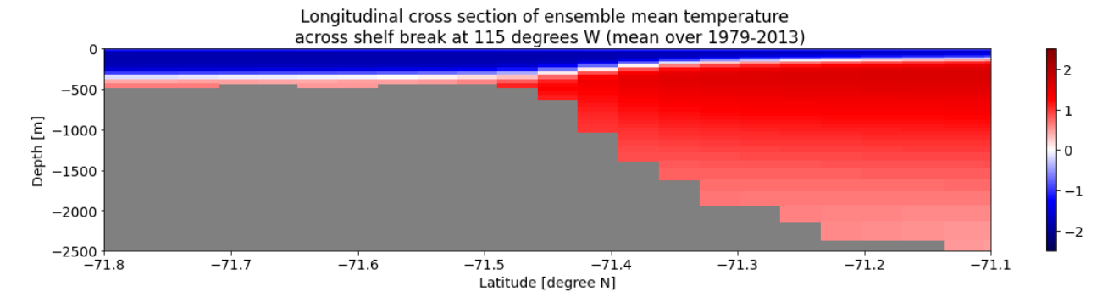
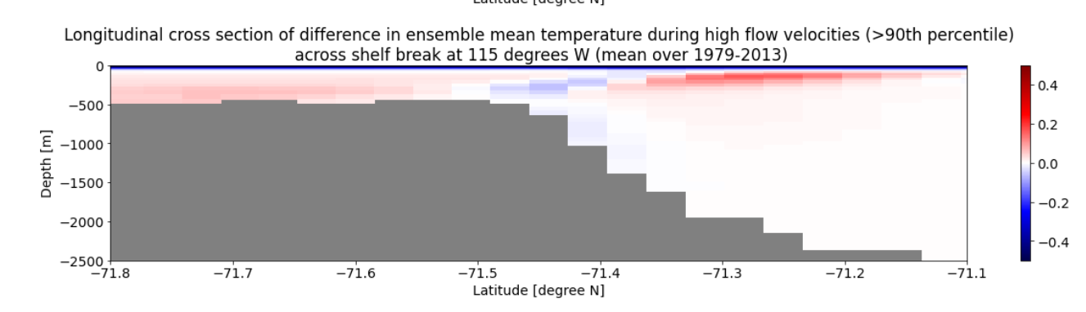
Mechanism: negative curl on shelf→ upwelling? → +/- temperature gradient → increased flow?
[C]
[C]

Slide 15
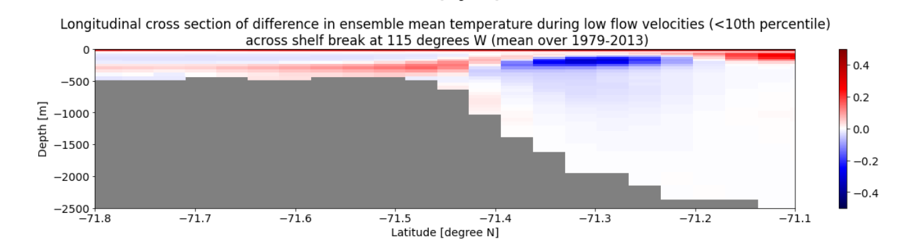

Slide 16
Some conclusions
“surf. wind stress” → but maybe also sea ice?
Wind stress curl spatially very variable, less predictable?
Less control of the tropical variability on the wind stress curl than on zonal wind?
PITE wind box maybe too large
1940s not strong in mean stress curl → no strong response!
Alessandro?

Slide 17
What to add next
High melt and low melt events: - correlation map with melt - composite with time series - composite animation?
Barotropic baroclinic. How does wind stress curl relate to wind? Why is ENSO response so weak in 1940s?
When do we get convection?

Slide 18
Evidence for Option 2

Slide 19
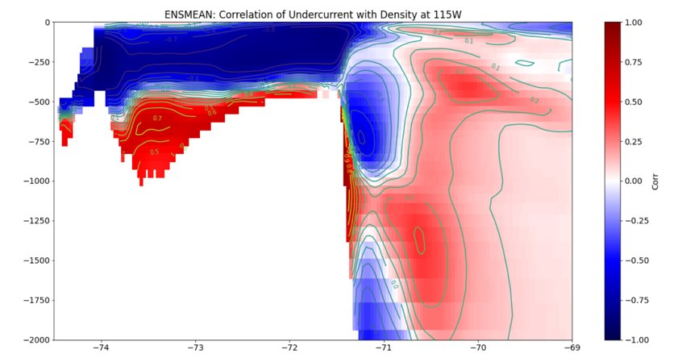

Slide 20
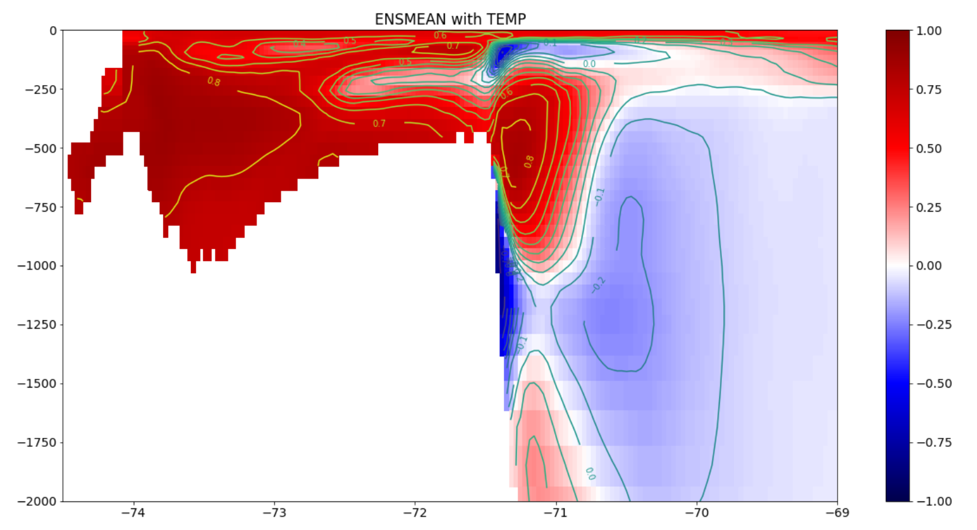

Slide 21
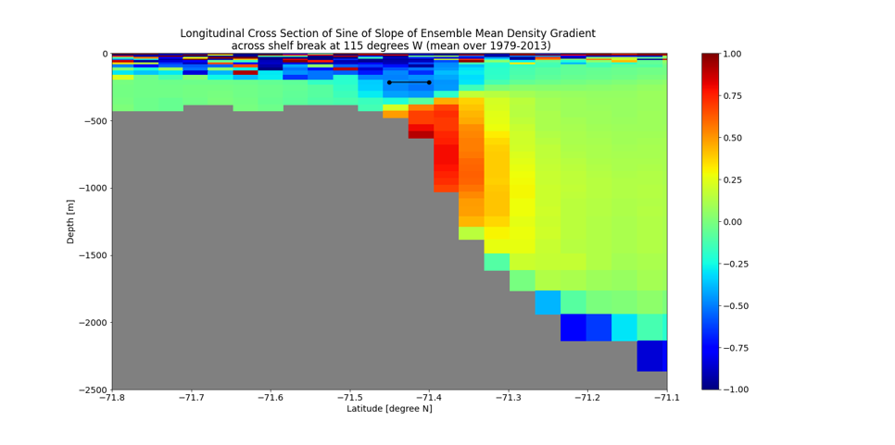
Different Attempts

Slide 22
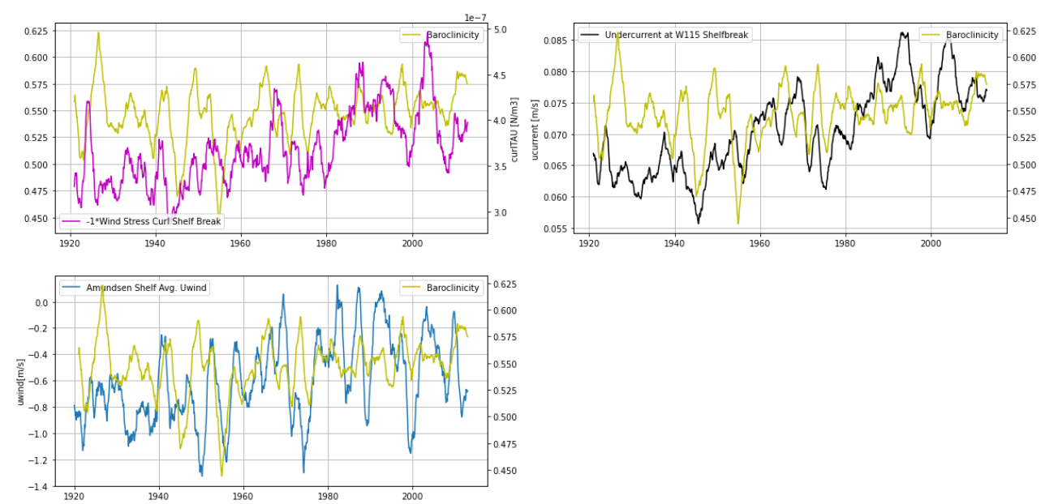
Upper Baroclinic Slope: ens mean

Slide 23
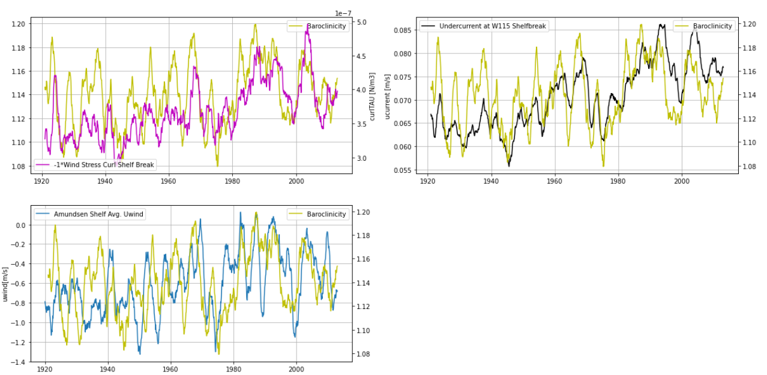
-1* Lower Baroclinic Slope: ens mean
Causality?

Slide 24
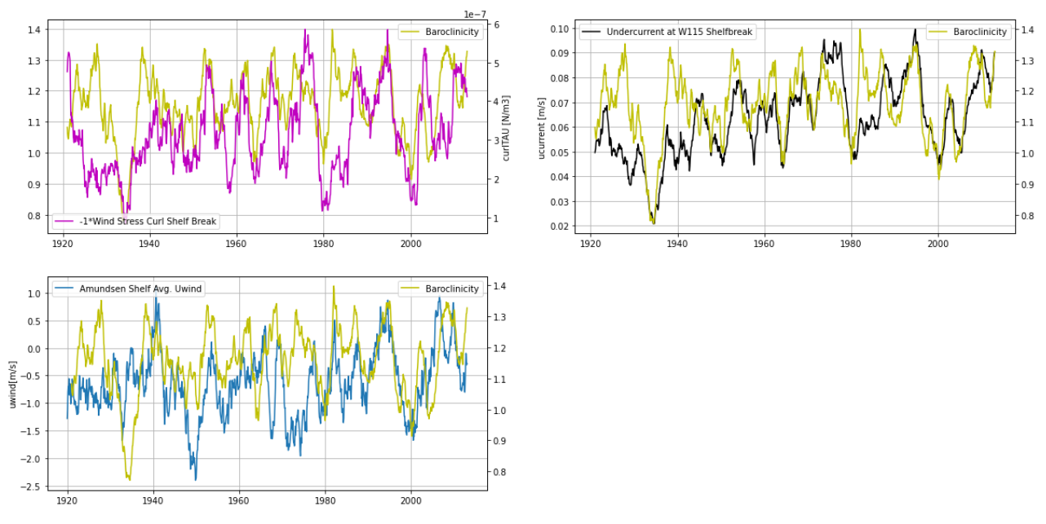
-1* Lower Baroclinic Slope: member 1

Slide 25
Summary
Wind stress curl seems to be dominant factor.
Lower baroclinicity important, but it does not seems to be a ‘switch’, but it just follows the curl→ mechanism? Or effect?
EMAIL ADELE!

Slide 26
To Do
Warm and Cold Events
Mechanism
How does wind stress curl relate to wind? Why is ENSO response so weak in 1940s?
When do we get convection?
Matlab
Organize code
Make files smaller

Slide 28
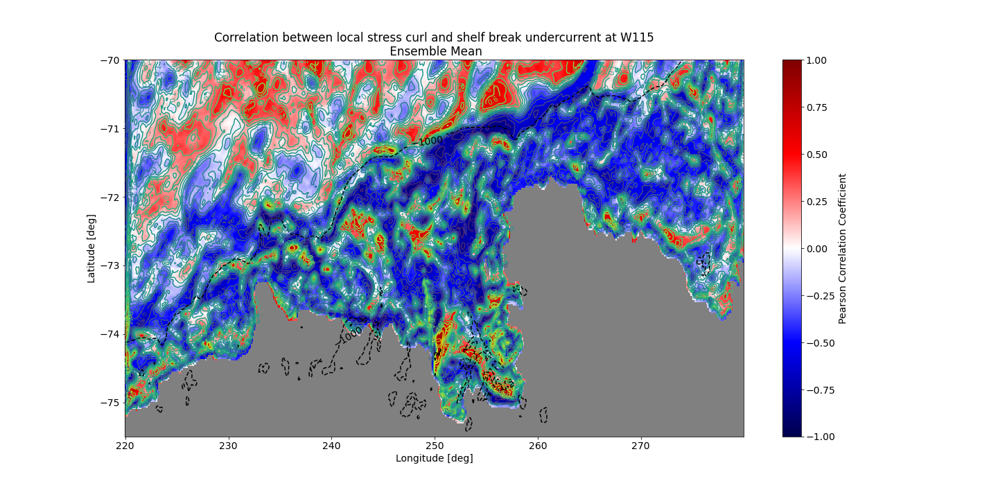

Slide 29
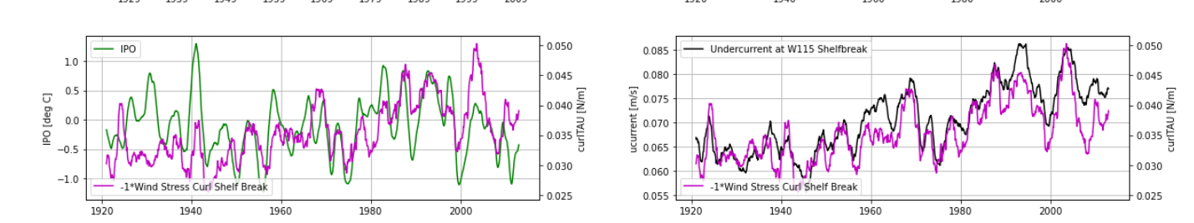
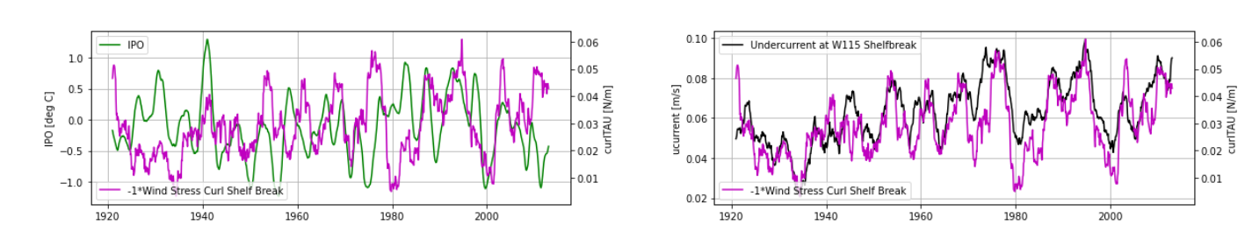
Stress Curl: Ensemble Mean
Stress Curl: Ensemble Member 1

